Slide 1
Analysis And Design Of Algorithms
Maximum Subarray (Divide and Conquer)
223841 Malak Mohamed

Slide 2
The points that will be discussed :
The design of maximum subarray.
The visualization of this algorithm.
The implementation of this algorithm.
The analysis of this algorithm.

Slide 3
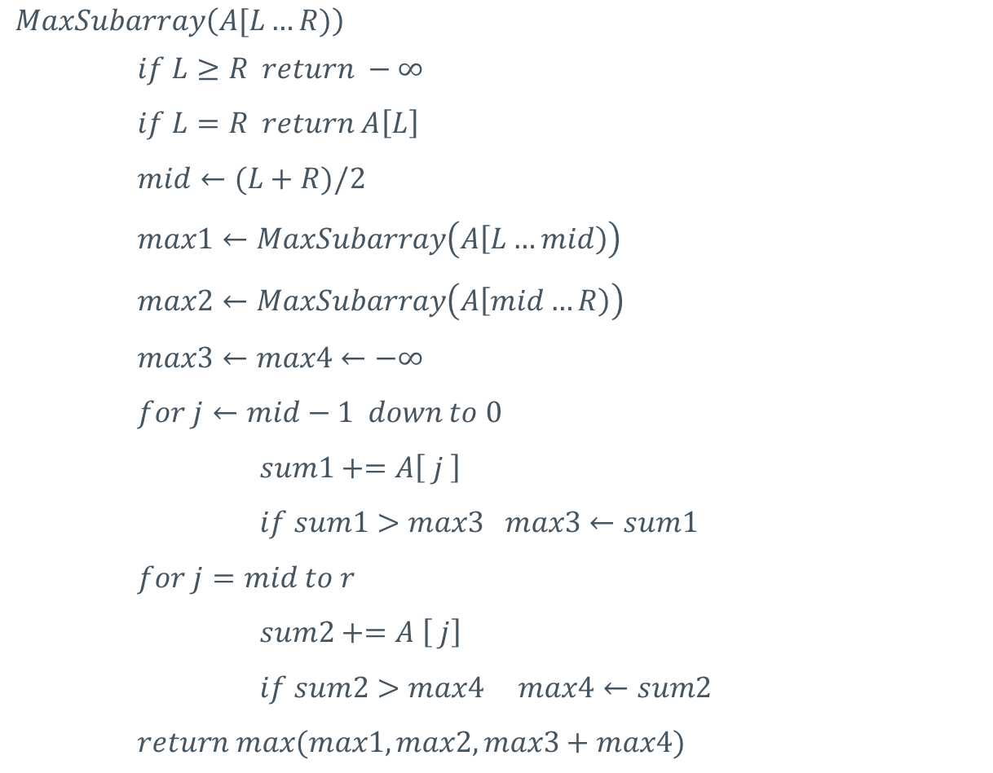
The design of maximum subarray (Pseudocode) :
$$MaxSubarray\left(A[L…R)\right)$$
$if L≥R return −∞$
$if L=R return A\left[L\right]$
$mid←(L+R)/2$
$max1←MaxSubarray\left(A\left[L…mid\right)\right)$
$max2←MaxSubarray\left(A\left[mid…R\right)\right)$
$$max3←max4←−∞$$
$for j←mid−1 down to 0$
$sum1+=A\left[ j \right]$
$if sum1>max3 max3←sum1$
$$for j=mid to r$$
$sum2+=A \left[ j\right]$
$if sum2>max4 max4←sum2$
$$return max(max1, max2,max3+max4)$$

Slide 4


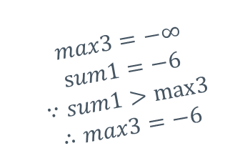

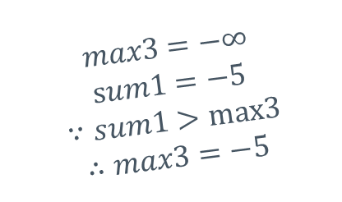
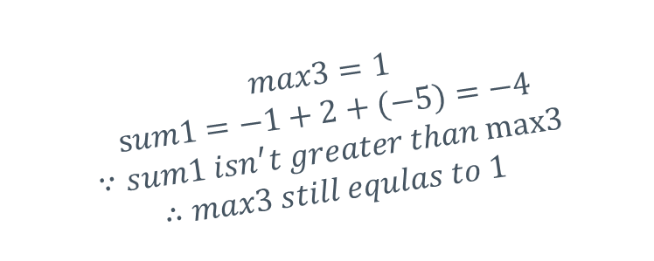



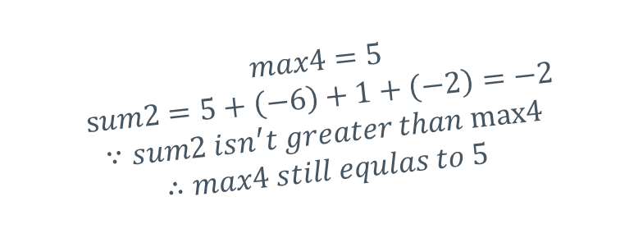


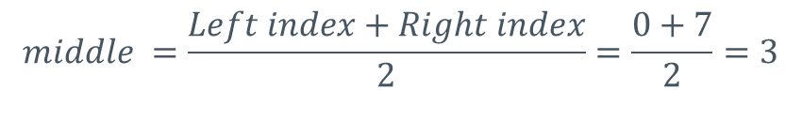


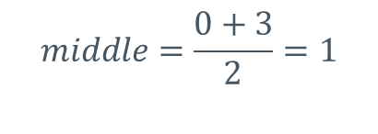

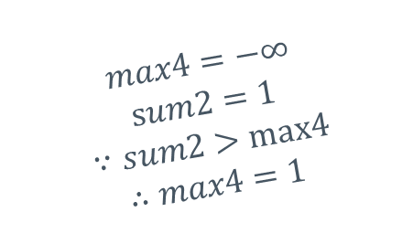








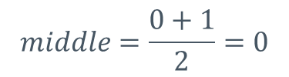

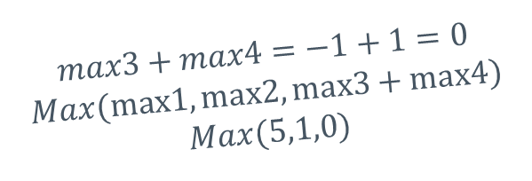


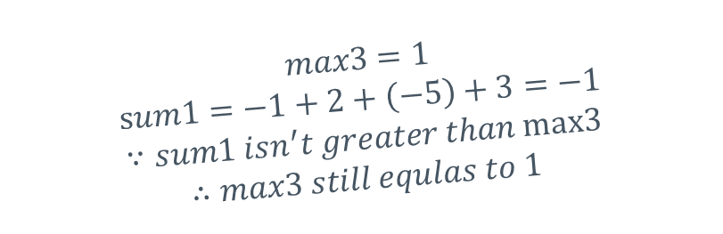









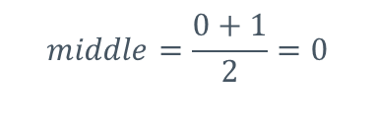
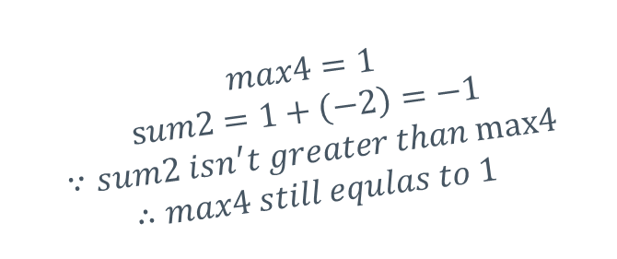





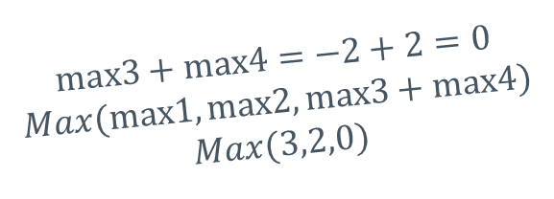





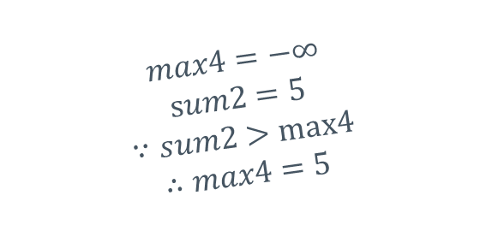
The design or visualization of this algorithm
$$middle =\frac{Left index+Right index}{2}=\frac{0+7}{2}=3$$
$$index$$
0
1
2
3
4
5
6
7
3 | -5 | 2 | -1 | 5 | -6 | 1 | -2
$$middle=\frac{0+3}{2}=1$$
$$middle=\frac{0+3}{2}=1$$
$$max1=3$$
$$index$$
$$max2=5$$
1
0
1
2
3
$$index$$
0
2
3
3 | -5 | 2 | -1
5 | -6 | 1 | -2
$$max4=1$$
$$sum2=1+\left(−2\right)=−1$$
$$∵sum2 isn^{′}t greater than max4$$
$$∴max4 still equlas to 1$$
$$max3=1$$
$$sum1=−1+2+(−5)=−4$$
$$∵sum1 isn^{′}t greater than max3$$
$$∴max3 still equlas to 1$$
$$max4=5$$
$$sum2=5+\left(−6\right)+1=0$$
$$∵sum2 isn^{′}t greater than max4$$
$$∴max4 still equlas to 5$$
$$max4=5$$
$$sum2=5+\left(−6\right)=−1$$
$$∵sum2 isn^{′}t greater than max4$$
$$∴max4 still equlas to 5$$
$$max4=−∞$$
$$sum2=5$$
$$∵sum2>max4$$
$$∴max4=5$$
$$max4=2$$
$$sum2=2+(−1)=1$$
$$∵sum2 isn′t greater than max4$$
$$∴max4 still equlas to 2$$
$$max3=−6$$
$$sum1=−6+5=−1$$
$$∵sum1>max3$$
$$∴max3=−1$$
$$max4=5$$
$$sum2=5+\left(−6\right)+1+\left(−2\right)=−2$$
$$∵sum2 isn^{′}t greater than max4$$
$$∴max4 still equlas to 5$$
$$max4=−∞$$
$$sum2=1$$
$$∵sum2>max4$$
$$∴max4=1$$
$$max3=−5$$
$$sum1=−5+3=−2$$
$$∵sum1>max3$$
$$∴max3=−2$$
$$max3=1$$
$$sum1=−1+2+\left(−5\right)+3=−1$$
$$∵sum1 isn^{′}t greater than max3$$
$$∴max3 still equlas to 1$$
$$max3=−1$$
$$sum1=−1+2=1$$
$$∵sum1>max3$$
$$∴max3=1$$
$$max3=−∞$$
$$sum1=−5$$
$$∵sum1>max3$$
$$∴max3=−5$$
$$max3=−∞$$
$$sum1=−1$$
$$∵sum1>max3$$
$$∴max3=−1$$
$$max4=−∞$$
$$sum2=2$$
$$∵sum2>max4$$
$$∴max4=2$$
$$middle=\frac{0+1}{2}=0$$
$$middle=\frac{0+1}{2}=0$$
$$max3=−∞$$
$$sum1=−6$$
$$∵sum1>max3$$
$$∴max3=−6$$
$$middle=\frac{0+1}{2}=0$$
$$middle=\frac{0+1}{2}=0$$
$$max3+max4=1+5=6$$
$$Max(max1,max2,max3+max4)$$
$$Max(3,5,6)$$
$$max3+max4=−1+1=0$$
$$Max(max1,max2,max3+max4)$$
$$Max(5,1,0)$$
$$max3+max4=−2+2=0$$
$$Max(max1,max2,max3+max4)$$
$$Max(3,2,0)$$
$$index$$
0
1
$$index$$
1
$$max2=2$$
0
1
$$index$$
$$index$$
1
$$max1=3$$
0
0
3 | -5
2 | -1
$$max1=5$$
5 | -6
$$max2=1$$
1 | -2
$$index$$
$$index$$
0
$$index$$
$$index$$
0
0
$$index$$
0
0
$$index$$
$$index$$
0
0
0
$$index$$
3
-5
2
-1
5
-6
1
-2
$$max1$$
$$max2$$
$$max1$$
$$max2$$
$$max1$$
$$max2$$
$$max1$$
$$max2$$
This is the maximum subarray

Slide 5

The implementation of maximum subarray in Python :
$def MaxSubarray\left(A, L, R\right)$:
$if L>R:$
$return float(′−inf^{′})$
$if L==R:$
$return A\left[L\right]$
$mid=(L+R)//2$
$max1=MaxSubarray\left(A,L, mid\right)$
$max2=MaxSubarray\left(A, mid+1, R\right)$
$sum1, sum2=0, 0$
$max3, max4=float\left(′−inf^{′}\right), float(′−inf^{′})$
$for j in range \left(mid−1, L, −1\right):$
$sum1+=A\left[ j \right]$
$if sum1>max3:$
$max3=sum1$
$$for j in range \left(mid, R\right):$$
$sum2+=A \left[ j\right]$
$if sum2>max4:$
$max4=sum2$
$$return max(max1, max2,max3+max4)$$

Slide 6
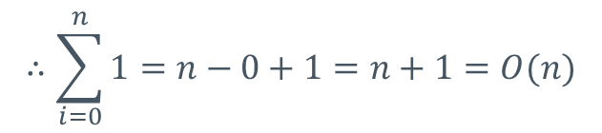

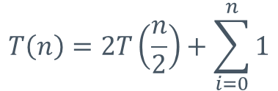


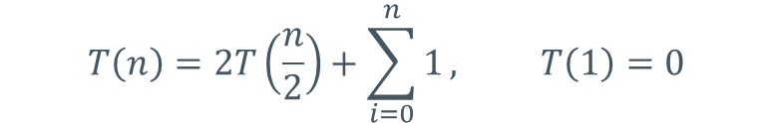





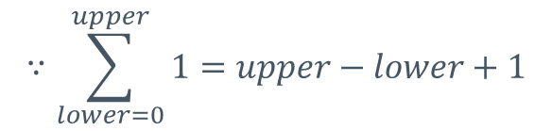

$$∵\sum_{lower=0}^{upper}{1}=upper−lower+1$$
Analysis of the maximum subarray algorithm :
$$T\left(n\right)=2T\left(\frac{n}{2}\right)+\sum_{i=0}^{n}{1}, T\left(1\right)=0$$
$$∴\sum_{i=0}^{n}{1}=n−0+1=n+1=O(n)$$
$$T\left(n\right)=2T\left(\frac{n}{2}\right)+\sum_{i=0}^{n}{1}$$
$$Substitute by T\left(\frac{n}{2}\right)=2T\left(\frac{n}{4}\right)+O(n)$$
$$=2T\left(\frac{n}{2}\right)+O(n)$$
$$Substitute by T\left(\frac{n}{4}\right)=2T\left(\frac{n}{8}\right)+O(n)$$
$$=2\left[2T\left(\frac{n}{4}\right)\right]+O(n)+O(n)$$
It seems like a pattern, so we can generalize it
$$=2\left[2[2T\left(\frac{n}{8}\right)]\right]+O(n)+O(n)+O(n\text{)}$$
$=2^{k}∗T(\frac{n}{2^{k}})+k∗O(n$)
$$=2^{\log{n}}∗T(1)+\log{n}∗n$$
$$0$$
$$=n log⁡n$$

Slide 7

Thanks a lot!

